Slide 1





Introducing INDIAN INSTITUTE OF TECHNOLOGY, GUWAHATI

Slide 2
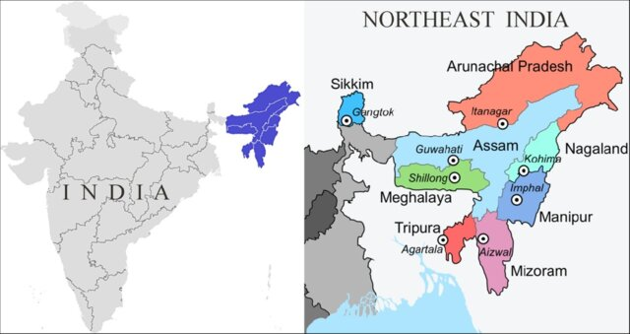
Where we are located
Image source: DOI: 10.18348/opzool.2021.1.69

Slide 3
Introduction
Indian Institutes of Technology (IITs) are the most sought after engineering institutes in India and the best ranked ones. Apart from engineering, the institutes also boast of a strong science and humanities component.
The IIT Guwahati, the sixth member of the IIT fraternity, is an autonomous institute under the Government of India and declared an ‘institute of national importance’.
Rankings:
Times Higher Education, 2014: IIT Guwahati the only academic institution in India that occupying a place among the top 100 world universities – under 50 years of age.
HackerRank, 2019. IIT Guwahati as the best university in the Asia-Pacific area for IT developers.
QS World University Rankings, 2022 : 41 rank globally, in the ‘Research Citations per Faculty’ category and overall 395 rank.
Union Ministry of Education's National Institutional Ranking Framework (NIRF), 2023: 7th place among engineering institutes, 9th among research institutes, and 9th in the overall rankings.
Times Higher Education Impact Rankings 2023: Ranked 6th globally in Sustainable Development Goal 7 (Affordable and Clean Energy)
Nature Index. 2023. IITG ranks 9th in the Academic Category and 12th in All Category in the Nature Index Ranking in India.
2

Slide 4
Some details
The Institute provides education at the Bachelor's (BTech), Master's (MA, MDes, MTech, MSc), and Doctoral (PhD) levels through its eleven departments and a number of interdisciplinary academic centers.
Total student strength: 7000+
In addition to its accomplishments in teaching and research, IIT Guwahati has been able to significantly fulfill the mandate the institute to help in the development of the North East region. This includes research and applications in the domain of healthcare, engineering solutions for local infrastructure problems and even in the defense sector.
The department of Humanities and Social Sciences offers courses at Masters and doctoral level, besides offering courses for B Tech level.
HSS department includes disciplines of Economics, History, Philosophy, Archaeology, Linguistics, English literature, political science, Development studies, Psychology.
3

Slide 5
Research Activities at IIT Guwahati
The Research and Development Office is the wing of the Institute which facilitates, channelizes, records, and regulates, as per the Institute rules, all the sponsored research projects and consultancy works in the Institute. The Research and Development Section is administered by the Dean of Research & Development.
The sponsored researches conducted till now has covered areas such as theoretical and applied aspects of core science (physics, chemistry and mathematics), social sciences, ICT, electronics, AI, material science, nanotechnology, biotechnology, alternative energy, environment, water resources, structural and earthquake engineering, geotechnical engineering, chemical engineering, heat transfer, machine design, manufacturing, product design, etc.
5

Slide 6
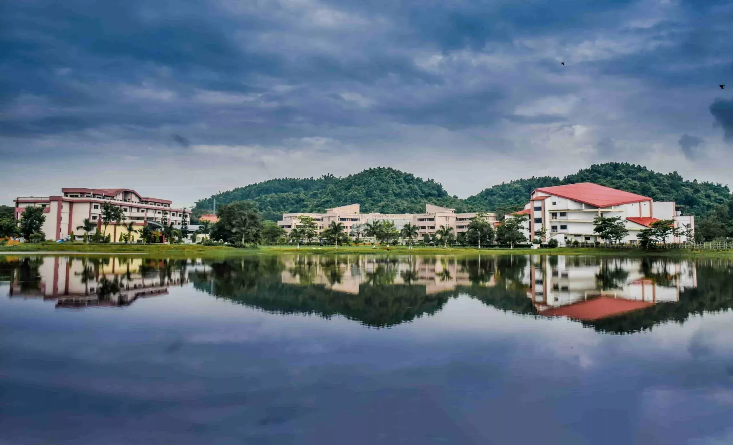
Introducing myself
Bidisha Som, Dept. of Humanities and Social Sciences and Centre for Linguistic Science and Technology.
Teach Linguistics: (2008- present).
Few of the courses I have been teaching: ‘Language, Culture and Cognition’, ‘Bilingualism’, ‘Introduction to language acquisition’, ‘language and thought’.
Primary research areas:
Bilingual language processing, cognitive control, language acquisition, crosslinguistic studies.

Slide 7
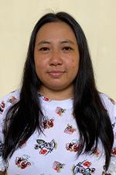
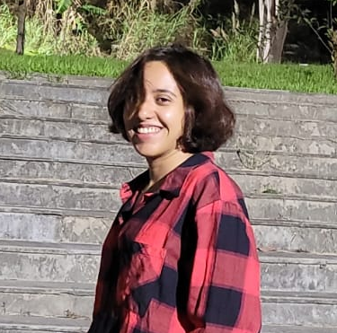
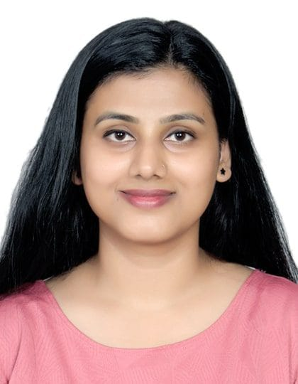
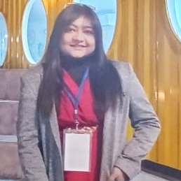
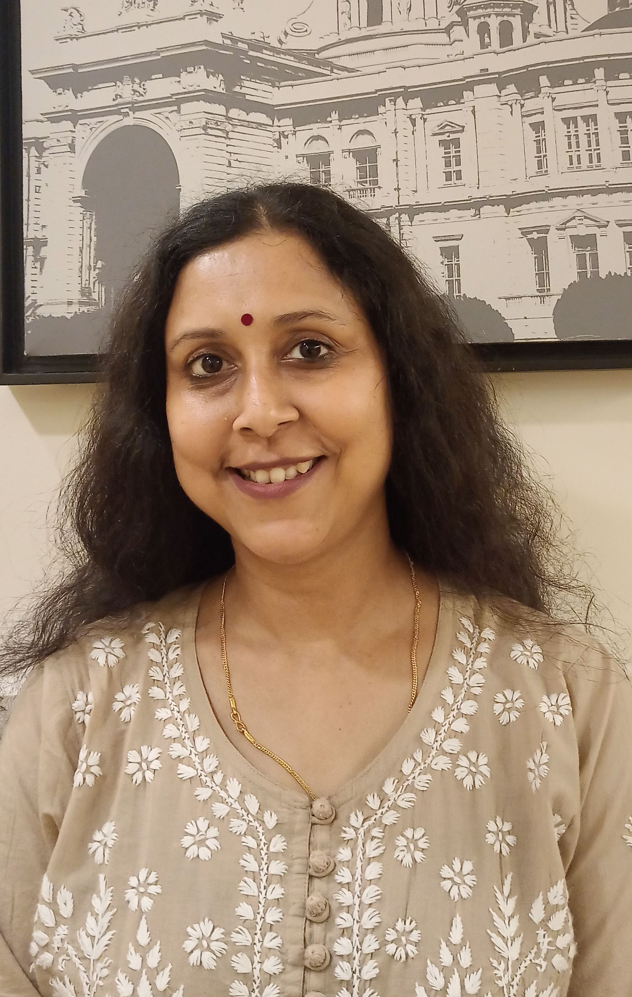
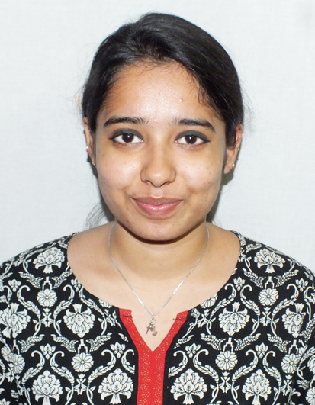
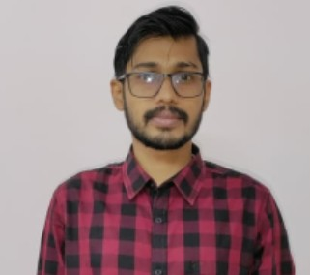
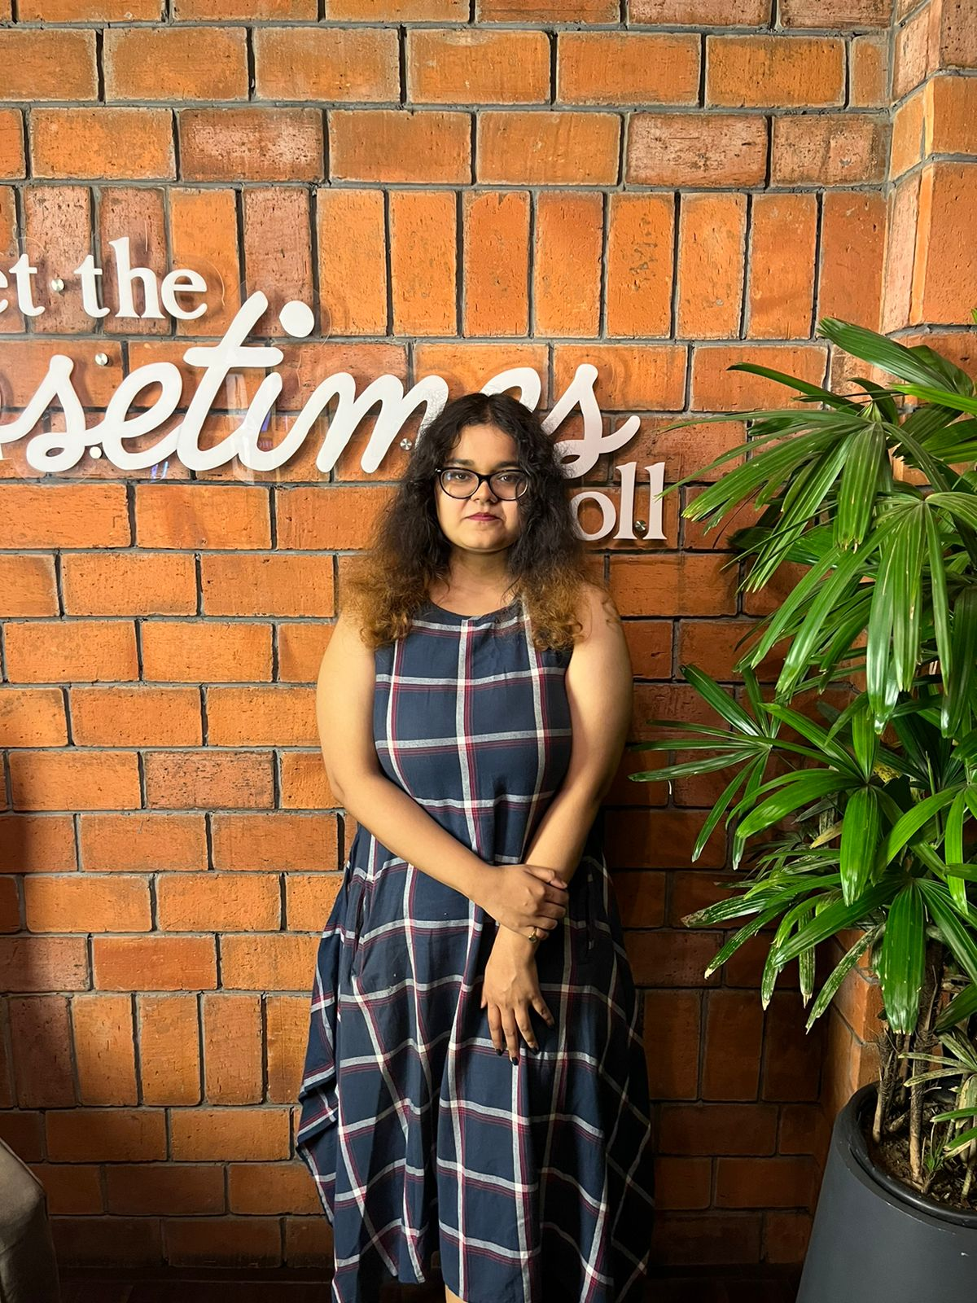
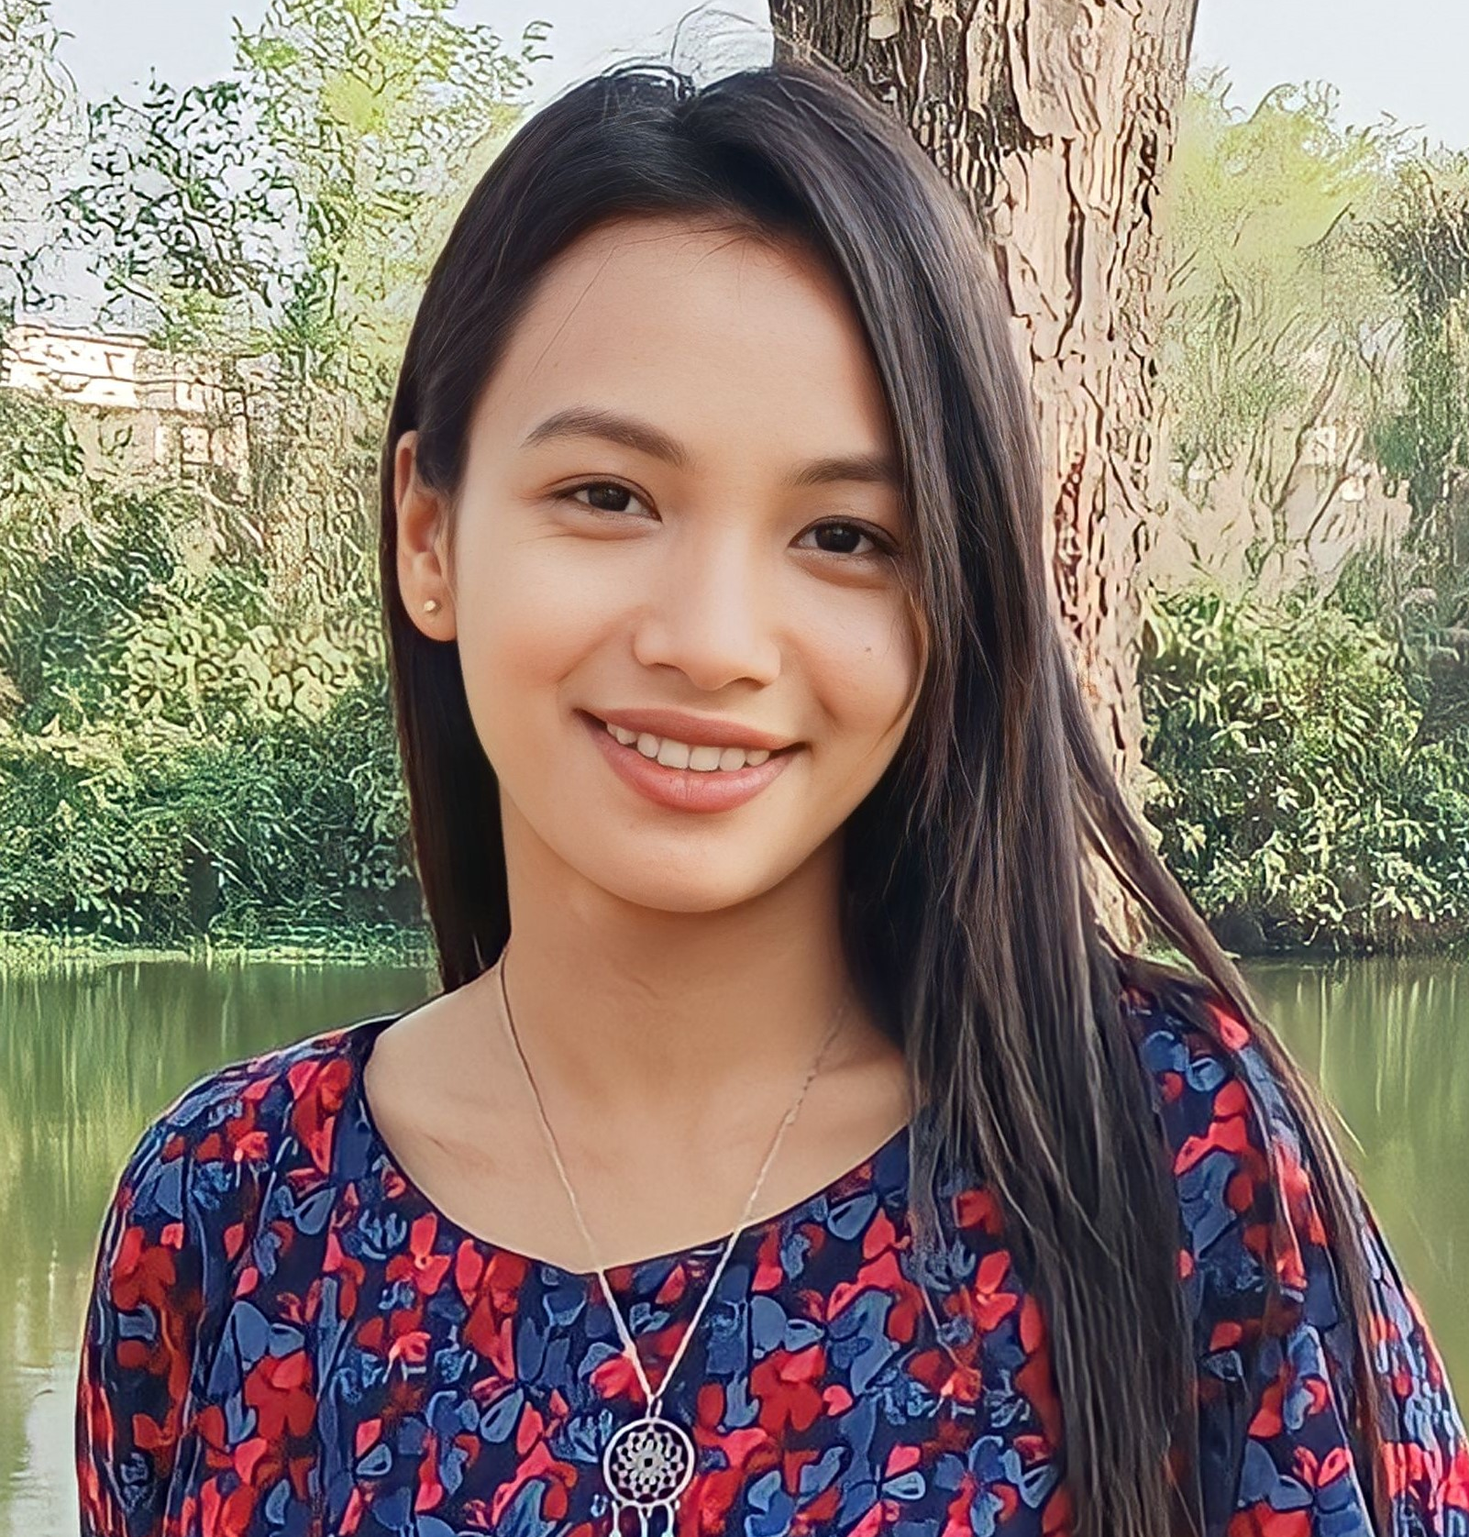
Language-Cognition group at IIT Guwahati
Opangienla Kechu
Role of context on bilingual language processing
Emily Thomas
Cognitive control
Shalu Kumari
Developing Digital Language Learning tools
Taznin Hussain
Language acquisition among atypical children
Dr. Bidisha Som
Associate Professor
HSS & CLST
Nilanjana Chowdhury
Nuances of Language dominance
Pratik Nanda
Spatial Cognition and language
Koyel Mukherjee
Language learning through graphics
Chumki Payun
Heritage Language Processing
11

Slide 8
Domains in which the scholars are engaged
The predominant focus of research revolve around cognitive investigations:
Bilingualism: language processing and how this is affected by the socio-cultural and interactional context.
Cognitive control mechanism among young adults and its interaction with language switching patterns.
Methods of Language Learning: Approaches in newer pedagogy of language learning, using digital platform and cognitive grammar as well as comics/graphics.
Heritage Language Processing: the processing strategies of heritage language: comprehension and production.
Cross-linguistic study of spatial cognition and language and its neural representation.
Language Processing among neurologically atypical children: Focus is on the children on the Autism Spectrum and how they produce and comprehend language.
6

Slide 9
Collaborations
Within IITG, I work together with other faculty members in areas of machine learning, acoustic studies of languages etc.
Internationally, I have collaborated with a large group of researchers in multi-lab studies in areas of facial feedback analysis, metaphor processing and trust in algorithm.(2 papers published. 3rd under review).
And now, I join the prestigious iBrain group.

Slide 10
Workplan for iBrain
Course material preparation
Research methods in language-cognition research, to be incorporated in the July-Nov semester’s course.
Activities at IITG
Monthly seminar series
Training workshop every two months
Monthly student corners
Travel
Student visits to partner institutes in India
Student visits to partner institutes in Europe
Visits by the Co-PI

Slide 11
iBrain seminar series on frontiers of brain and cognitive sciences
Monthly, tentatively during the third week of each month.
Experts specializing in diverse areas within neural and cognitive sciences will deliver talks, ensuring a high level of expertise and knowledge dissemination.
The target audience: students and researchers from IIT Guwahati as well as other neighboring institutes in Assam, as well as other North-eastern states. Expected participants 100.
The talks for July to October are already planned.
July: (to be finalized)
August: ‘Neuroscience and affective control’. (Prof. Tushar Singh. IIT BHU)
September: ‘Latest developments in the field of cognitive science and prospects for future’. (Prof. Amitash Ojha, IIT Jammu).
October: ‘Android app for EEG and its use in neuroscience: some latest updates from the field’. (Prof. Navin Gupta. Prof of Bioscience, IITG).
8

Slide 12
iBrain Training-workshop: methods in brain and cognitive sciences
Aims to facilitate researchers with rich practical training in cutting edge tools and methods used in experimental research. This will help enhance their knowledge through active participation. providing a recurring platform for participants to engage and immerse themselves in an intensive learning environment.
Target audience/participants: Researchers from IITG and nearby institutes.
Target number: not exceeding 50.
Four workshops are planned:
August: Application of eye-tracking in cognitive science research. Prof. Jayprakash Singh. CBCS.
October: EEG in language and cognition. Prof. Kamal Kumar Chaudhury. IIT Ropar.
December: Tools for statistical data analysis in cognitive science research. Faculty expert to be finalized)
Language-cognition research using behavioral methods. (Bidisha Som and others)
9

Slide 13
Students’ corner
The student journal club operates as a fully student-run program.
This will foster an environment where students from diverse institutes converge to engage in scholarly discussions, present papers, foster collaborations, and exchange ideas.
This platform serves as a catalyst for researchers within similar domains, facilitating the exploration of novel concepts and stimulating the development of more robust research endeavors.
10

Slide 14
Travel
Tentative travel plans (subject to discussion with partner institutes)
July: Student (2) visit to BITS Pilani
August: Student (1) visit to ENS
September: Visit to NU/Arhus; Bidisha + student (1)
October: Student (3) visit to UOH

Slide 15
THANK YOU
12

